Slide 1

Agile Delivery for scalable supply chain platform
Case Study By:
Sumeet Boob

Slide 2
Agenda
Business Context & Objectives
Solution Scope & NFRs
Target Architecture
Agile Delivery Strategy
Delivery Organization & Resource Model
Estimation & Capacity Planning
Engineering & Delivery Framework
Governance, Risks & Assumptions
Engagement Model
Key Takeaways
Agile Delivery for Scalable Supply Chain Platform
2

Slide 3
Context & objectives
Objective: Design a scalable digital supply chain platform enabling suppliers, operators, and logistics partners to manage inventory, orders, and deliveries with real-time visibility.
In Scope
Supply chain platform (web & mobile)
Inventory & order management
Supplier integration
Analytics dashboards
Out of Scope
Supplier ERP changes
Logistics internal systems
Hardware/infrastructure changes
Agile Delivery for Scalable Supply Chain Platform
3

Slide 4
Scope & Non-Functional Requirements
Functional Scope
Non-Functional Requirements
The platform will deliver an end-to-end digital solution for managing supplier onboarding, inventory visibility, order processing, and delivery tracking across web and mobile channels, allowing businesses to oversee inventory, orders, and deliveries via both web and mobile interfaces.
Authorized business users will have the capability to initiate and oversee orders with multiple third-party suppliers, covering the entire order lifecycle within the platform.
The system will streamline inventory control, order processing, and product tracking, offering real-time insights into product availability and delivery progress.
A data platform will facilitate the gathering, analysis, and reporting of operational data to enhance demand and supply planning, support decision-making, and improve operational efficiency.
Additionally, the solution will provide near real-time monitoring and operational analytics, empowering production teams to effectively oversee platform health and perf.
Performance – API response time < 2 seconds under normal load; validated through performance testing.
Usability – Responsive web and mobile interfaces supporting consistent experience across devices.
Security – RBAC-based access control with complete audit trail for all data operations.
Availability – Platform designed for 99.99% uptime SLA with continuous access during business operations.
Scalability – Auto-scaling services to handle varying workloads without manual intervention.
Maintainability – Centralized logging and diagnostics to enable faster issue identification and resolution.
Supportability – Real-time monitoring and alerts for application and infrastructure health.
Extensibility – Modular architecture allowing new services or integrations without impacting existing functionality.

Slide 5
AGILE Delivery PLAN
Discovery & Architecture (3 Weeks)
Objective: Understand current platform and define architecture & MVP scope. Use of Generative AI to analyze existing system, legacy APIs, data models and documentation.
Deliverables
Current system assessment
Target architecture definition
Product backlog creation
NFR validation
DevOps & environment setup
Sprint 0
Platform Foundation (Sprint 1-2)
Goal: Establish core platform capabilities.
Sprint 1
User authentication & RBAC
Web application framework
Core API framework
Supplier onboarding
Sprint 2
Supplier management
Inventory management
Order creation workflow
Initial database setup
Deliverable 👉 Core platform ready
It-1
MVP Delivery (Sprints 3–4)
Goal: Deliver first usable supply chain platform.
Sprint 3
Inventory workflows
Order lifecycle tracking
Supplier catalog integration
Notifications (basic)
Sprint 4
Shipment tracking
Web portal enhancements
Supplier API integration
Operational dashboards
Deliverable 👉 MVP Release (End of Sprint 4)
It-2
Mobile & Integrations (Sprints 5–6)
Goal: Expand access and external integrations.
Sprint 5
Android application
Supplier API integrations
Order tracking improvements
Sprint 6
Logistics partner integration
Shipment tracking enhancements
Notification improvements
Deliverable 👉 Multi-channel supply chain platform
It-3
Scalability & Reliability (Sprints 7–8)
Goal: Improve platform scalability and operational maturity.
Sprint 7
Event-driven messaging
Performance optimization
Auto-scaling setup
Sprint 8
Monitoring & observability
Security enhancements
Integration hardening
Deliverable 👉 Enterprise-grade scalable platform
It-4
Data & Insights (Sprints 9–10)
It-5
Goal: Enable analytics and operational insights.
Sprint 9
Data pipelines
Reporting services
Demand–supply analytics
Sprint 10
Power BI dashboards
Operational KPIs
Advanced analytics
Deliverable
👉 Supply chain analytics & insights
Production Readiness
Final
Goal: Prepare platform for production rollout.
Activities
Performance & load testing
Disaster recovery validation
Security validation
Production deployment preparation
Documentation & knowledge transfer
Deliverable 👉 Production-ready platform

Slide 6
Solution Architecture Overview
1️⃣ Experience Layer – Multi-Channel Access Platform supports: • iOS (Swift) • Android (Kotlin) • Web Portal (ReactJS) Clients interact through REST APIs ensuring consistent logic and secure access across devices. 👉 UI remains thin — business logic resides in APIs. | 3️⃣ Business Services Layer Modular domain services handling core supply-chain processes. • Inventory Service • Order Management • Supplier Integration • Tracking Service Services communicate via standard APIs. 👉 Business logic centralized and independently scalable. | 5️⃣ Data Platform Supports operational data and analytics. • SQL Server / PostgreSQL – transactional data • Python pipelines – data processing • Power BI dashboards – reporting 👉 Operational and analytical workloads separated.
2️⃣ Secure API Layer (.NET Core) Central gateway for all client interactions. SSO authentication through Azure AD Role-based access control Request validation and API governance Centralized audit logging Routes validated requests to backend services. 👉 Controls access, security, and API governance. | 4️⃣ Integration Layer Handles communication with external platforms. • Supplier Systems • SAP Cloud • Logistics Platforms Connectors isolate external dependencies from internal services. 👉 External failures do not impact core services. | 6️⃣ Cloud & DevOps Foundation (Azure) Provides the underlying platform capabilities. • Azure App Services / Containers • CI/CD pipelines (Azure DevOps) • Monitoring & Observability • Auto-scaling infrastructure 👉 Supports SLA, performance, and operational resilience.

Slide 7
Architecture Benefits & WORKFLOW
Client Apps
(Web & Mobile)
↓
API Gateway / Edge Security
↓
Identity Service
↓
Microservices
↓
Event Bus
↓
Databases / Analytics
↓
Azure Infrastructure
Scalable Microservices Independent services (Inventory, Orders, Supplier, Tracking) scale without impacting the full platform.
Secure API Access API Gateway + SSO enable authentication, rate limiting, and controlled access.
Real-Time Visibility Event-driven messaging supports near real-time inventory and order lifecycle updates.
High Availability Architecture Azure deployment with containerization enables auto-scaling and 99.99% SLA resilience.
Loose External Integrations Supplier, SAP, and logistics systems isolated through integration services.
Data & Analytics Optimization Transactional systems separated from analytics pipelines (PowerBI insights).
Operational Observability Centralized monitoring, logging, and alerting for faster issue resolution.
Extensible Platform Design API-first modular design enabling easy addition of suppliers and capabilities.

Slide 8
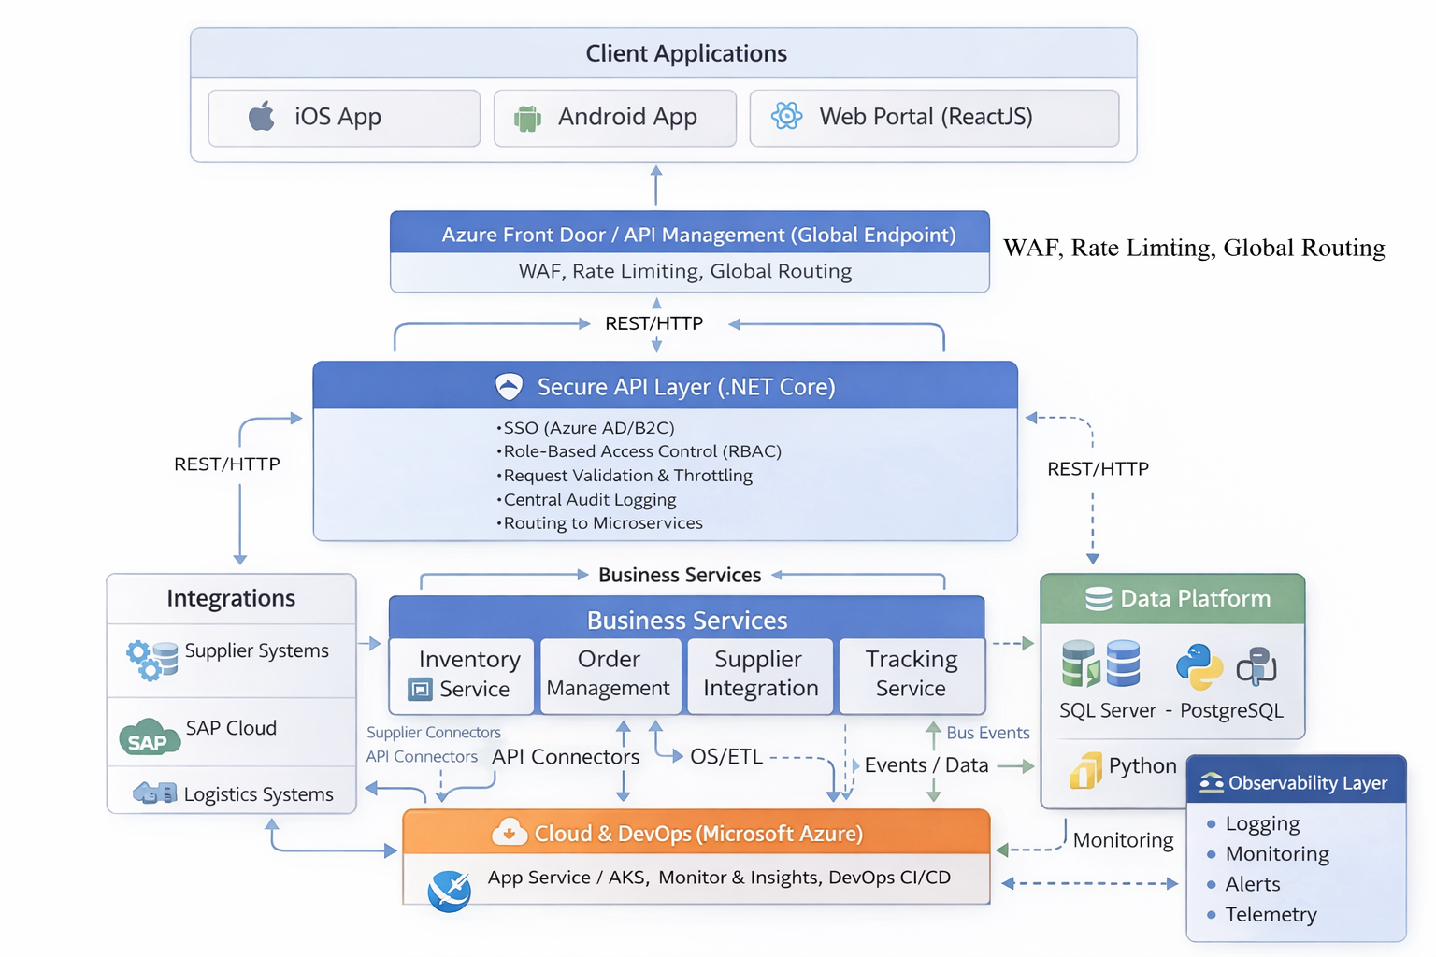
Reference Architecture

Slide 9
Scrum Rhythm
Sprint Planning Define sprint goal and commit stories based on team capacity.
Daily Standups 15-minute sync to track progress, blockers, and dependencies.
Backlog Refinement Mid-sprint grooming to prepare upcoming work items.
Sprint Review Demo completed features to stakeholders for feedback.
Retrospective Identify improvements to increase delivery efficiency.
-------------------------------------------------
Artifacts
Product backlog
Sprint backlog
Release roadmap
-------------------------------------------------
Key Delivery Metrics
Sprint Velocity
Sprint Burndown
Defect Leakage
Lead Time / Cycle Time

Slide 10
Definition of Ready & Done
Definition of Ready
Definition of Done
Operational Controls
Story enters sprint only if:
Business workflow identified
NFR expectations defined
API contract agreed
External dependencies validated
Data & monitoring impacts assessed
Story completed only when:
Feature validated (Web + Mobile)
API performance benchmark met
Security & RBAC verified
Integration tests passed
Monitoring dashboards updated
No critical defects
SLA Gate – performance validation
Observability Gate – structured logs & alerts
Data Integrity Gate – reporting consistency
Platform Consistency – Web & Mobile parity
👉 Backlog baseline established during Sprint-0 with scope changes managed through backlog reprioritization within fixed delivery capacity.

Slide 11

Engineering Excellence & Delivery Acceleration
Toolchain Azure DevOps
Git
PowerBI
Monitoring tools
CI/CD Pipeline Build →
Test →
Security scan →
Deploy
Reliability & Monitoring API monitoring Observability (Logging, Metrics, Alerts)
Test Pyramid 70% Unit
20% Integration
10% UI
Day-0 Delivery Enablement
Architecture baseline finalized Dev/QA environments & CI/CD ready MVP backlog refined Integration access validated
Generative AI Engineering
AI assisted code generation
Automated test case generation
Code review and defect detection
Documentation generation
11

Slide 12
Project Governance & Resource loading
Delivery Team Structure
RACI Matrix
Governance Cadence
Role | # of Resources
Delivery Manager | 1
Solution Architect | 1
Scrum Master | 2
Tech Leads | 3
Backend Engineers | 5
Frontend Engineers | 4
Mobile Engineers | 3
Business Analysts | 2
QA Engineers | 4
DevOps Engineers | 2
Data Analyst | 1
Total | 28
(5 Delivery Pods comprising of backend, frontend, mobile, QA & DevOps)
Activity | Delivery Manager | Solution Architect | Product Owner | Scrum Master | Engineering
Architecture decisions | A | R | C | C | C
Backlog prioritization | C | C | R | C | I
Sprint planning | C | C | R | R | A
Delivery execution | A | C | C | R | R
Release approval | A | R | C | C | C
Daily
Scrum ceremonies
Scrum of Scrums
Weekly
Status report (WSR)
Sprint metrics review
Monthly
Client governance (MBR)
Delivery & financial health review
Release Checkpoints
Architecture review
Go-live readiness
Legend:
R = Responsible A = Accountable C = Consulted I = Informed

Slide 13
MVP Delivery pod structure
Pod 1 Web Platform (MVP Core)
Pod 2 – Web Platform (MVP Extensions)
Pod 3 – Mobile Enablement
Pod 4 – Platform Engineering
Pod 5 – Data & Analytics
Focus
Core supply chain workflows
Team
Tech Lead (1)
Backend Engineers (2)
Frontend Engineer (1)
QA Engineer (1)
Scope
Supplier onboarding
Inventory management
Order lifecycle
Core Platform APIs
Focus
Completing MVP user workflows
Team
Tech Lead (1)
Backend Engineers (1)
Frontend Engineer (1)
QA Engineer (1)
Scope
Shipment tracking
Supplier integrations
Web portal UX
Notifications
Focus
Mobile application enablement for supply chain workflows
Team
Tech Lead (1)
Mobile Engineers (2)
QA Engineer (1)
Scope
Shipment tracking
Supplier integrations
Web portal experience
Notifications
Focus External system integration and platform infrastructure enablement.
Team
Backend Engineer (1)
DevOps Engineers (2)
QA Engineer (1)
Scope
Supplier Integration APIs
SAP / logistics integrations
CI/CD pipelines
Infrastructure automation
Focus Operational analytics and data-driven supply chain insights.
Team
Data Analyst (1)
Frontend Engineer (1)
Mobile Engineer (1)
Backend Engineer (1)
Scope
Data pipelines
Reporting services
Power BI dashboards
Operational insights
Platform Expansion Pods : Scrum Master (1)
MVP Delivery Pods : Scrum Master (1)
Shared Program Governance: Delivery Manager (1), Solution Architect (1), Business Analysts (2)
👉 MVP delivered by end of Sprint 4 👉 Pods 1–2 focus on MVP delivery while Pods 3–5 build platform capabilities enabling rapid post-MVP expansion.

Slide 14
Work Breakdown structure (WBS)
1. Discovery & Architecture
Current platform assessment
Target architecture definition
Product backlog creation
DevOps environment setup
2. Platform Foundation
Authentication & RBAC
Core API framework
Web application framework
3. Integration Layer
Supplier API integrations
SAP cloud integration
Logistics system integration
4. Supplier & User Onboarding
Supplier registration workflows
Catalog integration
User role management
5. Inventory & Order Management
Inventory tracking
Order lifecycle workflows
Shipment tracking
6. Mobile Applications
Android application
iOS application
7. Data & Analytics Platform
Data pipelines
Reporting services
Power BI dashboards
8. Quality Engineering
Unit testing
Integration testing
Automation framework
9. DevOps & Deployment
CI/CD pipeline implementation
Infrastructure automation
Monitoring & observability
10. Production Readiness
Performance testing
Disaster recovery validation
Security validation
Production deployment

Slide 15
Program Estimation & Delivery Capacity
Estimates
Delivery Capacity
Timeline
Workstream (Module) | Estimated SP
Discovery & Architecture | 80
Platform Foundation | 180
Integration Layer | 220
Supplier & User Onboarding | 160
Inventory & Order Management | 220
Mobile Applications | 200
Data & Analytics Platform | 180
Quality Engineering | 120
DevOps & Deployment | 120
Production Readiness | 80
Total Platform Size (in SPs) | ~1,600
Parameter | Value
Delivery Pods | 5 pods
Pod Size | ~5 engineers
Velocity per Pod | 25–30 SP / sprint
Total Program Velocity | ~150 SP / sprint
Sprint Duration | 2 weeks
Metric | Value
Total Estimated Size | ~1600 SP
Program Velocity | ~150 SP / sprint
Delivery Sprints | ~10 sprints
Sprint 0 | 3 weeks
Stabilization & rollout | ~4 weeks

Slide 16
Engagement Model & Commercial Structure
Engagement Model Comparison
Managed Services (Fixed Capacity / Price)
Engagement Value: ~$1.2-1.35m
Target Margin: ~40–45%
Program Duration: ~6 months
Team Size: 25–30 engineers
Sprint Throughput: 150–170 SP / sprint
Total Delivery Capacity: ~1600 SP
Recommendation: Managed services engagement provides predictable delivery capacity, stable pod structure and controlled cost while allowing backlog reprioritization across sprints.
Model | Managed Services (Recommended) | Time & Material
Delivery Structure | Fixed delivery capacity (pods) | Flexible staffing
Cost Model | Fixed delivery envelope | Hourly billing
Delivery Scope | Defined delivery capacity (~1600 SP) with backlog prioritization | Dynamic backlog
Cost Predictability | High | Medium
Use Case | Core platform delivery | Continuous evolution
Agile Delivery for Scalable Supply Chain Platform
16

Slide 17
Risks & Assumptions
Risks
Supplier integration complexity
Data migration challenges
Performance under peak demand
Integration dependency risk
Data quality inconsistencies
Assumptions
Access to existing platform baseline and Azure infrastructure
Client SMEs available for backlog refinement
Supplier APIs accessible for integration
Historical data available for analytics
Business SLAs & KPIs clearly defined – for all types of clients

Slide 18
Key Takeaways
Business-Centric Supply Chain Platform A scalable digital platform enabling suppliers, operators, and logistics partners to manage inventory, orders, and deliveries with real-time visibility.
Early Value Through MVP Delivery Core supply chain capabilities delivered by Sprint 4, enabling early business validation while additional platform capabilities evolve incrementally.
Scalable & Secure Architecture Microservices-based architecture on Azure with API-first design enabling modular scalability, secure integrations, and operational resilience.
Predictable Agile Delivery Model Cross-functional pods operating in parallel ensure stable velocity, delivery predictability, and reduced execution risk.
Business Impact & Long-Term Value Fixed capacity engagement provides cost transparency, improved delivery margins, and a foundation for continued platform expansion and account growth.
18

Slide 19
Thank You!

